Slide 1
CES 361
Fundamentals of Software Testing
Session 2

Slide 2
Four Components of a Test Case
What are they?
When can you write the first two?

Slide 3
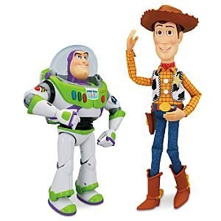
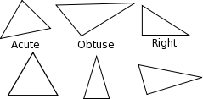
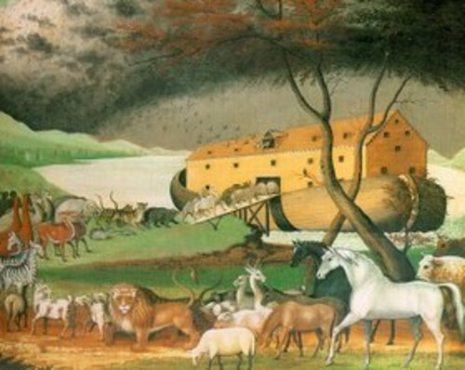
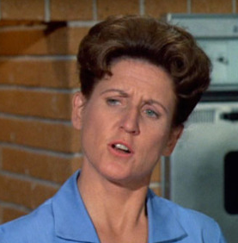
Exercise: Triangle Program
everyone get a testing buddy, okay?
Input: Three integers
Output: One four-word sentence
(the triangle is ____________)
Equilateral Isosceles Scalene
Your mission:
Write the requirements
Write the test plan
For example:
Test Case 1
Input: 4, 4, 4
Exp Out: Equilateral
Remember:
Test Case ∈ Test Plan
Your Goal:
Achieve the “Equipoise of Testing”

Slide 4
What are your requirements?
What are your test cases?

Slide 5
Assignment 1
Introduction
Your goal is to write (and test!) a program that rolls dice for computer games.
The software should be written as a reusable component (class).
The dice roller program should allow a user (or client) to specify the number of dice
to be rolled, anywhere from 1 to 5 dice at a time (for example, in Backgammon or Monopoly, two dice would be used. Risk would use up to three; Yahtzee would use
up to five.)
You can assume your program only needs to roll 6-sided dice.

Slide 6
Assignment 1
What you need to do:
1. Write requirements for your program. (Remember, requirements generally start with “The program shall…”) The essence of many of your requirements are included the introductory paragraph above, but not necessarily all of them. Be explicit.
2. Figure out how you will test your program, and write test cases to form a comprehensive test plan. (Remember, each test case will have an initial condition, a specified input, an expected output, and an actual result.) Be sure to write your test cases in a format that Alice could both understand and execute.
3. Write the software itself. You can some preliminary ad-hoc testing to make sure it seems to be running before you run your formal test plan.
4. Run the test plan, documenting the results. NOTE: If your test plan finds an error, do not fix your program before completing the test plan. Instead, mark the test case as “Failed,” and continue with your test plan. Once you put on your tester’s hat, complete the test plan before you don your programmer’s hat again. If you fix your program, rerun the entire test plan when you are done debugging.

Slide 7
Assignment 1
Challenges in this assignment:
1. What is “randomness?” How will you define it for Alice?
2. You will need to collect a large number of results to test for randomness. This means you may need to write additional software in order to test your software.
3. There is more to this than making sure the values on each die are somewhat evenly distributed. Think about this. This is your chance to shine. Remember SUE.
4. We will cover error testing later in the course. For this assignment, I want you to focus on proving that your dice roll randomly.

Slide 8
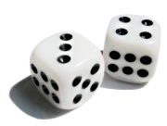
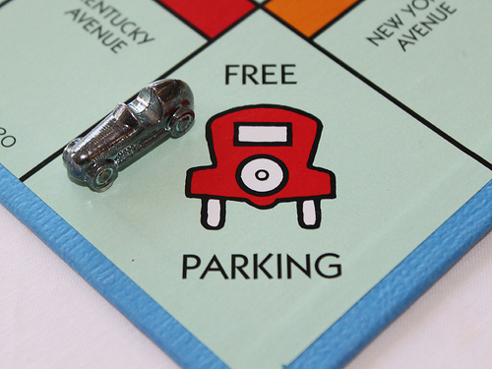
Assignment 1
Before you think this is stupid...

Slide 9
Assignment 1
What you should turn in:
1. The requirements (I expect this will fit on a single page).
2. The test plan, with the actual results, as if Alice had run it (I expect this will take at least a few pages). If you ran your test plan more than once, include multiple copies of the test plan (more on this later).
3. OPTIONAL: Program output from an automated test, if needed (only if it is in some sort of tabulated or summarized form; I do not want to see thousands of individual dice roll results on reams of paper). You can also reference printouts in the Actual Results section of each test case.
4. OPTIONAL: Source code, if it’s not too much trouble to include it.
5. A short paragraph or two summarizing what you did, and what you learned.

Slide 10
Assignment 1
How you will be graded - I will be most interested in these questions when I am assigning a grade:
1. Is the test plan thorough? Does it test for more than the obvious?
2. Is the test plan well-documented (with particular attention paid to actual results)?
Is the test plan neat and well-organized?
Could my wife or daughter run this test plan, as you have turned it in?
5. Would I have confidence in your program (particularly, in the fidelity of its randomness) based on the completed test plan that you turned in?

Slide 11
Questions?
If you have questions later, contact me.
I may elect to answer you on Pilot’s Discussion Board.

Slide 12
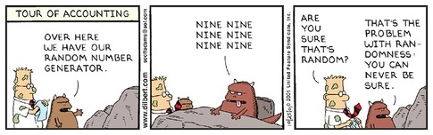
One Last Thought

Slide 13
This Slide Intentionally Left Blank

